Slide 1

Technical Blog
Using advanced java technology
By Aradhana Murarka

Slide 2
Introduction
The technical blog is a website that allows the end user to read the content online posted here and can also post about wherever in their mind under a specific category. This project is developed with the help of advanced java technology the blog posted by a single user will be categorized under a category such as java programming data structure , computer networks and web technology. The users can register themselves and can also view the profile of other users who had posted. The project allow people to come on internet platform and share there about their knowledge.

Slide 3
Description
This project is developed with the help of advanced java technology. This project allow people to come on internet platform and share there about knowledge. The blog posted by a single user will be categorized under a category such as java programming , data structure , computer networks and web technology. Only admin has the right to add new categories . the user may post a blog inside a specific category, including captions, images, title, description of the post. The content posted by the multiple users will be shown on the main page of the website and also on the profile page of the user the visitors can surf on the website locate the related content they are interested in, categorize all the posts and look for some specific post they only want to see. They may also like the post and add comments on the posts (if they have registered themselves and logged in to the website.

Slide 4
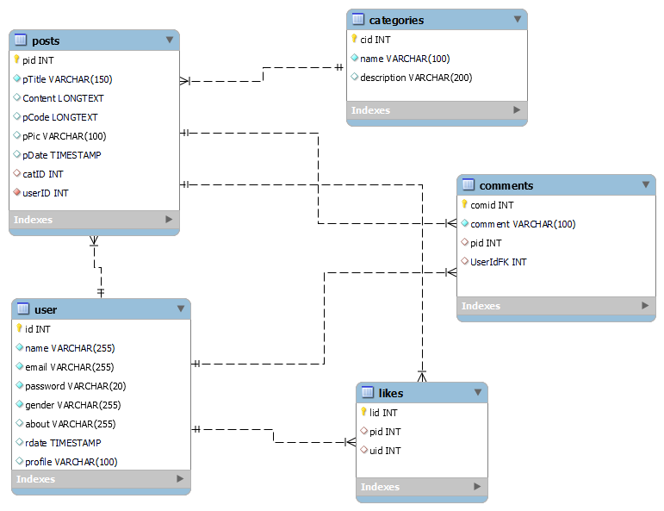
Database Setup
The database name is techblog which include many tables that are connect with each other with the help of foreign key
Tables -:
Categories
Likes
Post
Users
Comments
ER Diagram

Slide 5
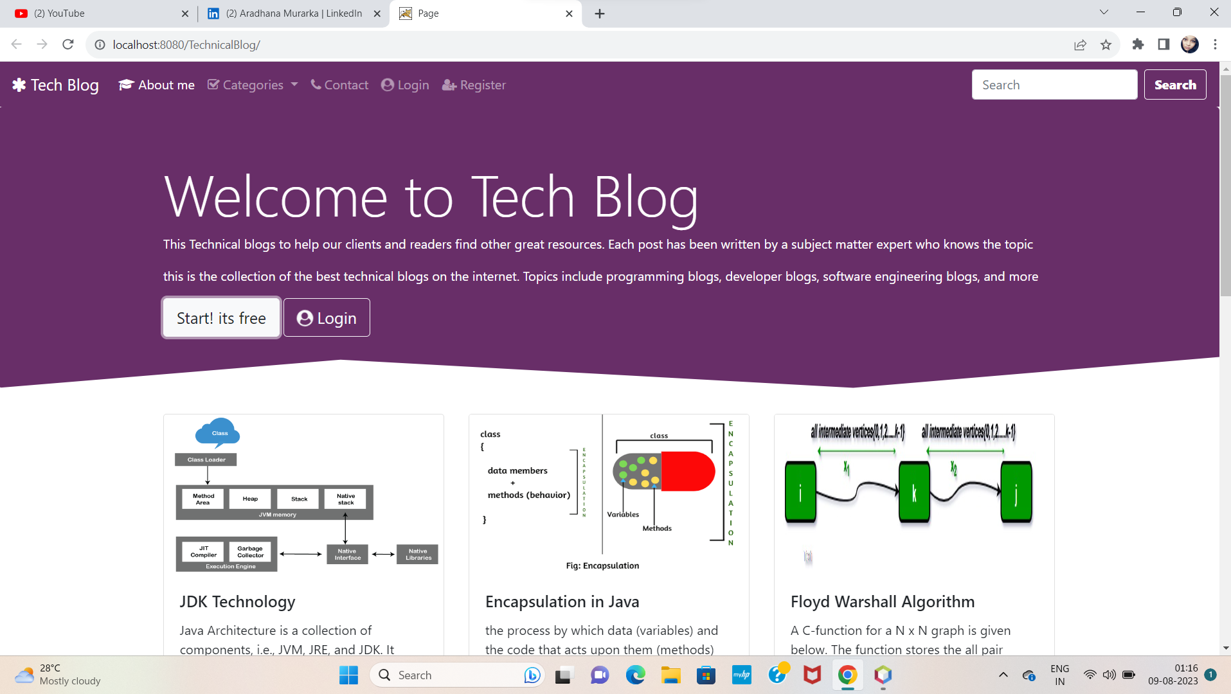
Index.jsp
The Home page
The posts are dynamically loading from database the user can filter the posts according to category

Slide 6
Connection Provider
There is a multiple time where I got to use SQL connection to insert or retrieve data from database to prevent making connection again and again connection provider is the utility class which can provide connection to any classes as a parameter to their constructor

Slide 7
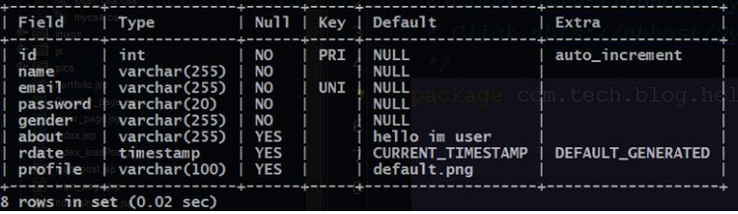
Registration Module
User table in the database which carries all the information about the user
Userdata→form→servlet-→userclassobject→database

Slide 8
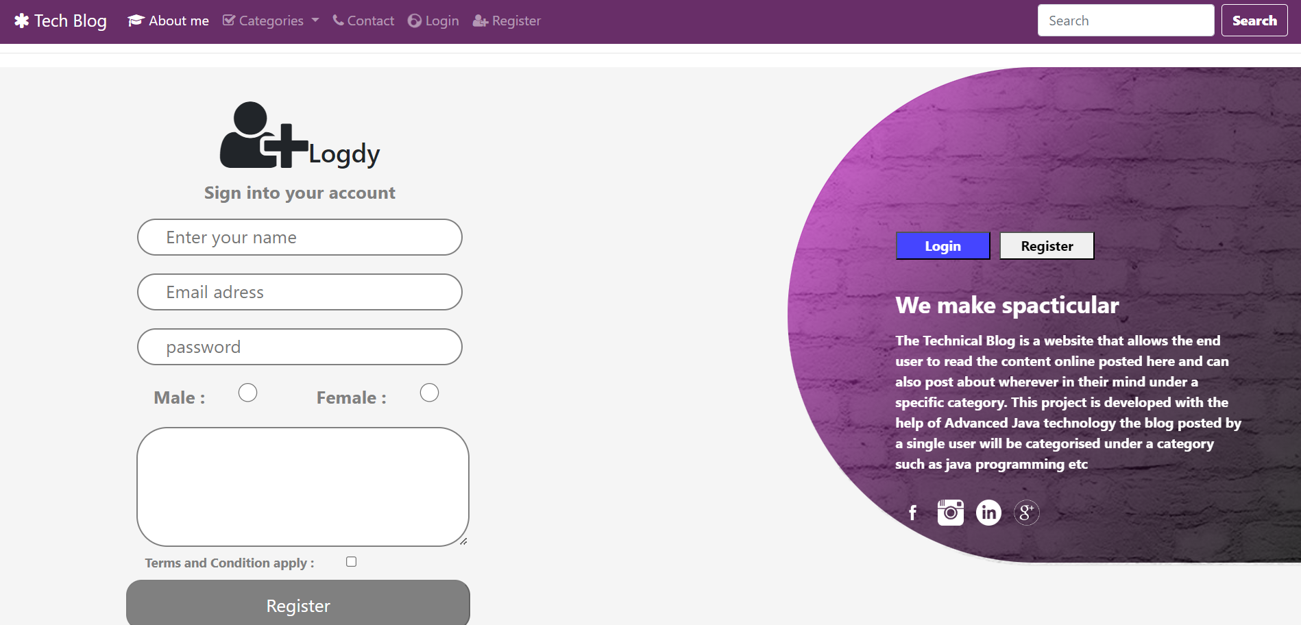
RegistrationPage.jsp
Registration page
The Resister button is disabled on the front end using JavaScript until the user fills all necessary details this prevents going null data on the server
This page is fully designed by me contains no bootstrap property

Slide 9
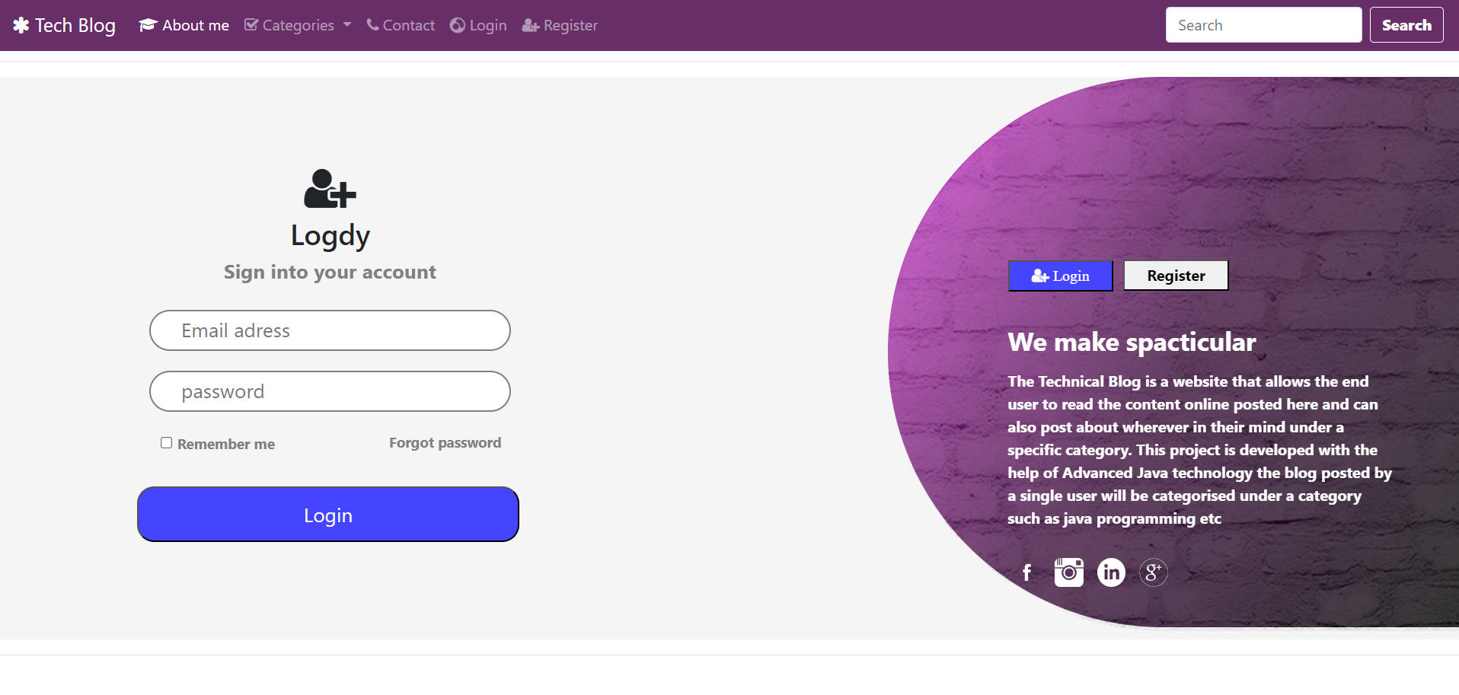
login.jsp
Login page
The login button is disabled on the front end using JavaScript until the user fills all necessary details this prevents going null data on the server
This page is fully designed by me contains no bootstrap property

Slide 10
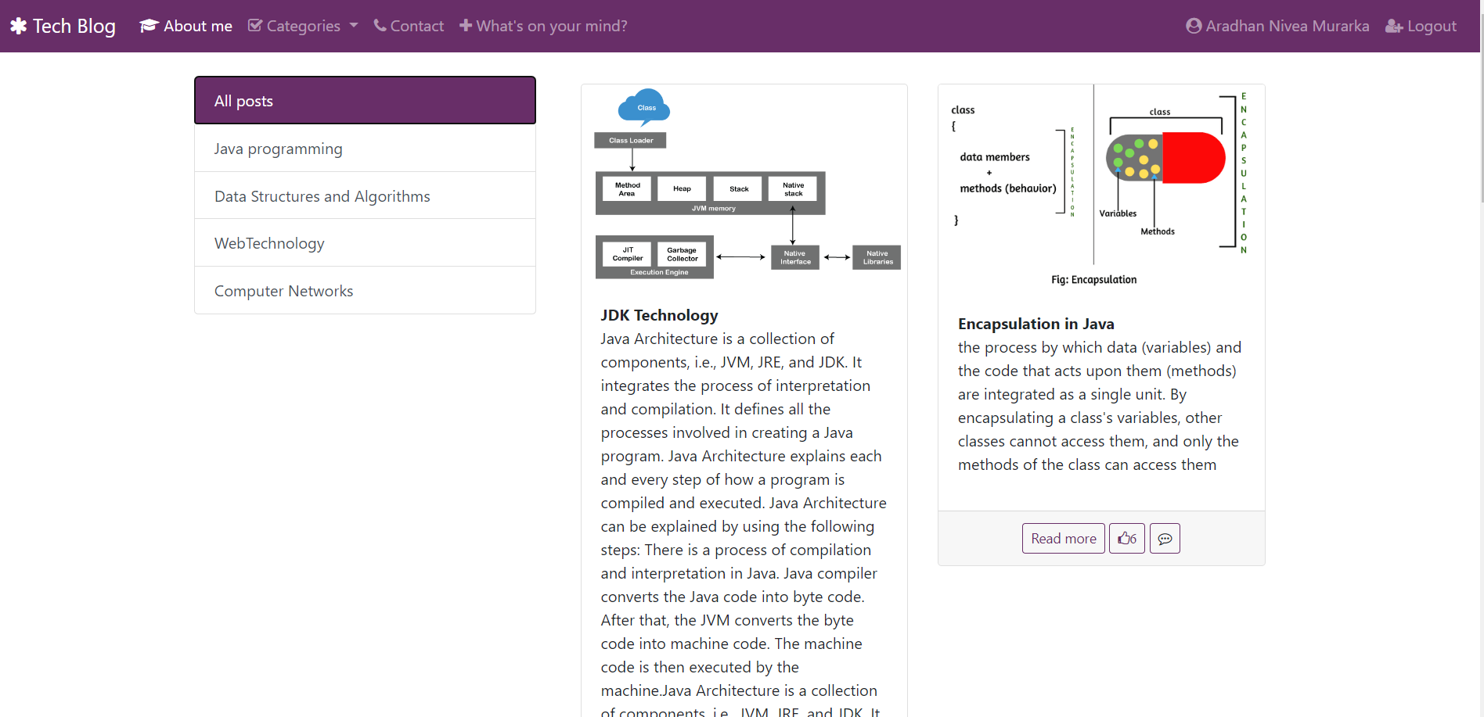
profile.jsp
Profile page
This profile page opens after the user is successfully logged in.
If the user == null than it will be redirected to login page. In this page user gets multiple models such as profile model profile edit model post blog model and logout model from here the user can view the multiple posts available
like and comment on it and can filter the posts according to the category.

Slide 11
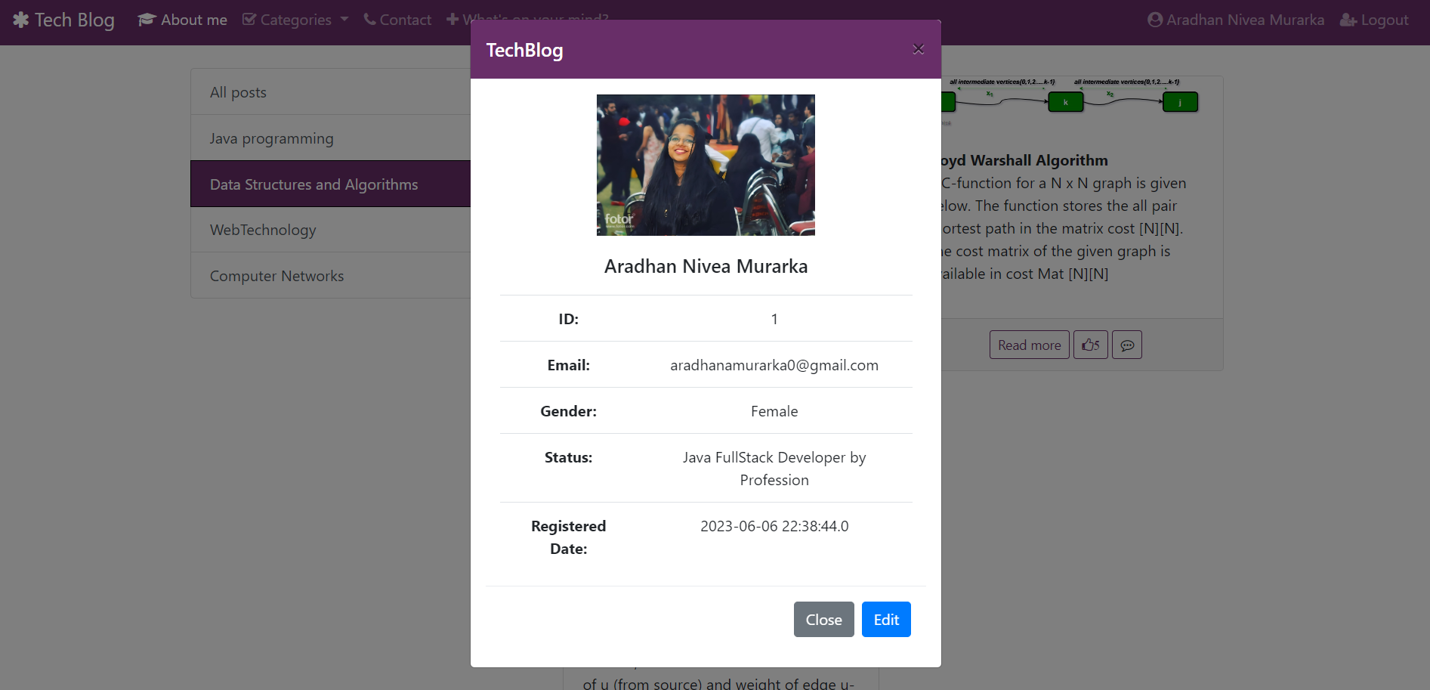
profile.jsp
User information
Once the user is logged in to the website the user information will be set in the session object and here all the data of the user is being fetched from the session object

Slide 12
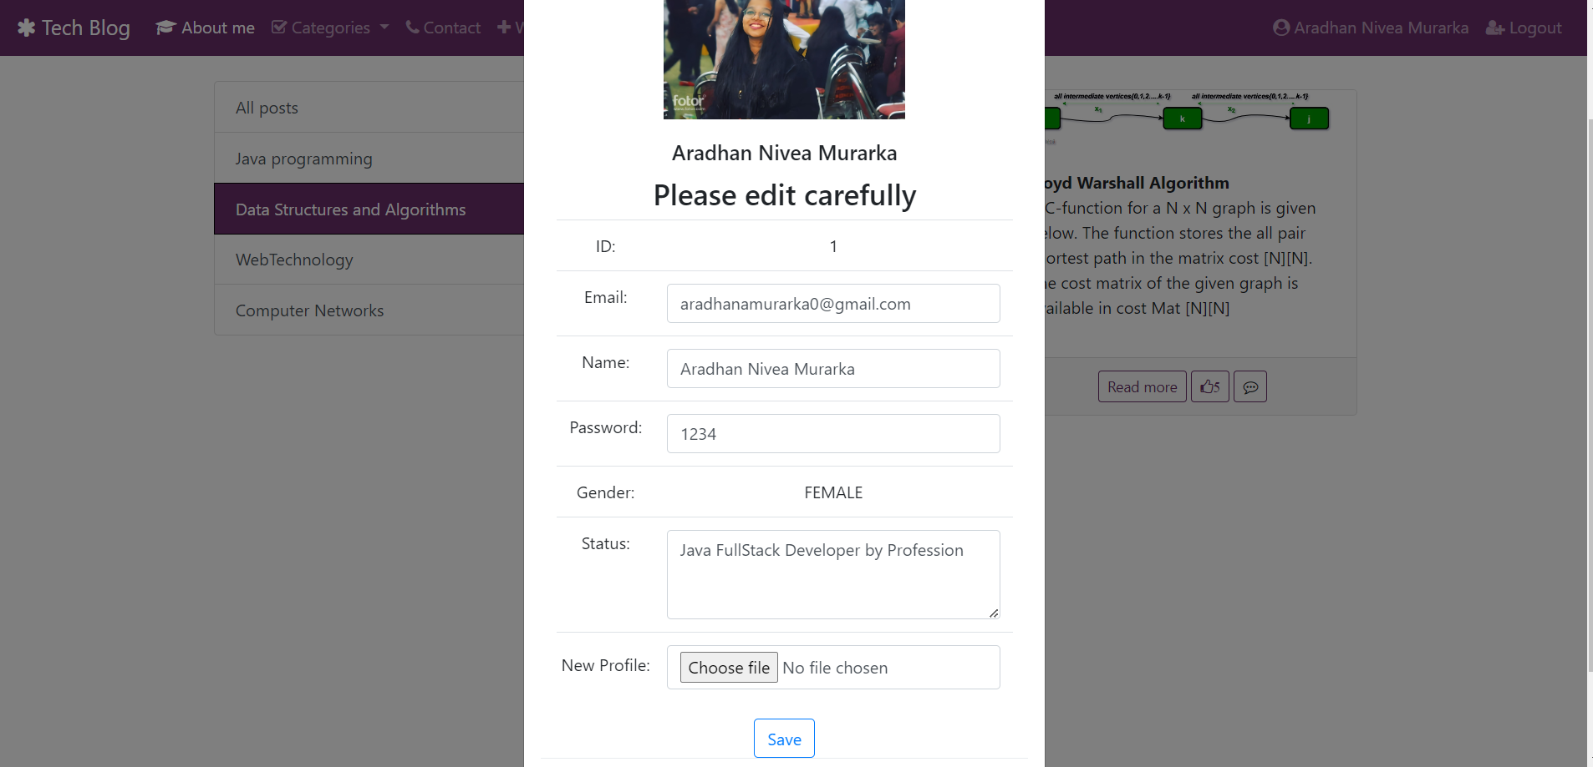
profile.jsp
User information Edit
User can modify his/her details such as name , password, email , profile picture and status (ID , gender ) cannot be modified

Slide 13
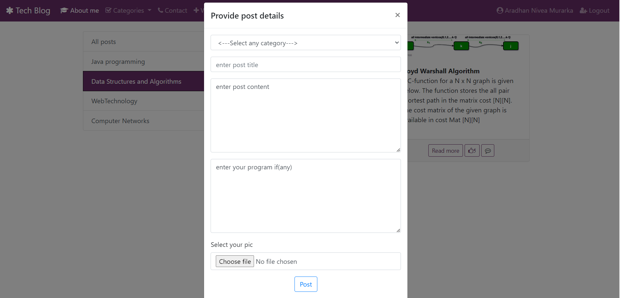
profile.jsp
Post Blog
This is the main thing the project is all about. Posting blog on the feed , here the user can post about whatever in his/her mind can share about there knowledge under a specific category. For posting a blog the fields that cannot be null are post category, post title post content ( code and image) are optional. If the user do not post the image than the post will be given a default post pic.

Slide 14
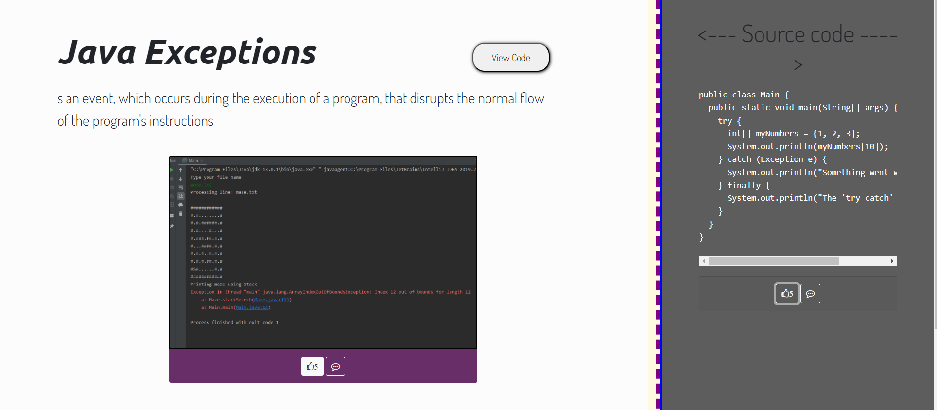
Blog page
After clicking on the read more button user will be redirected to this page. here the post id is being transferred to this page by url re-writing so that whenever you click on any post’s read more button you will be redirected to a dynamically loading page . here the user can read more about the blog view the code mage available by the one who posted it like and comment and can also view on which date this blog was posted and also the information of the user who posted it.
show_blog_page.jsp

Slide 15
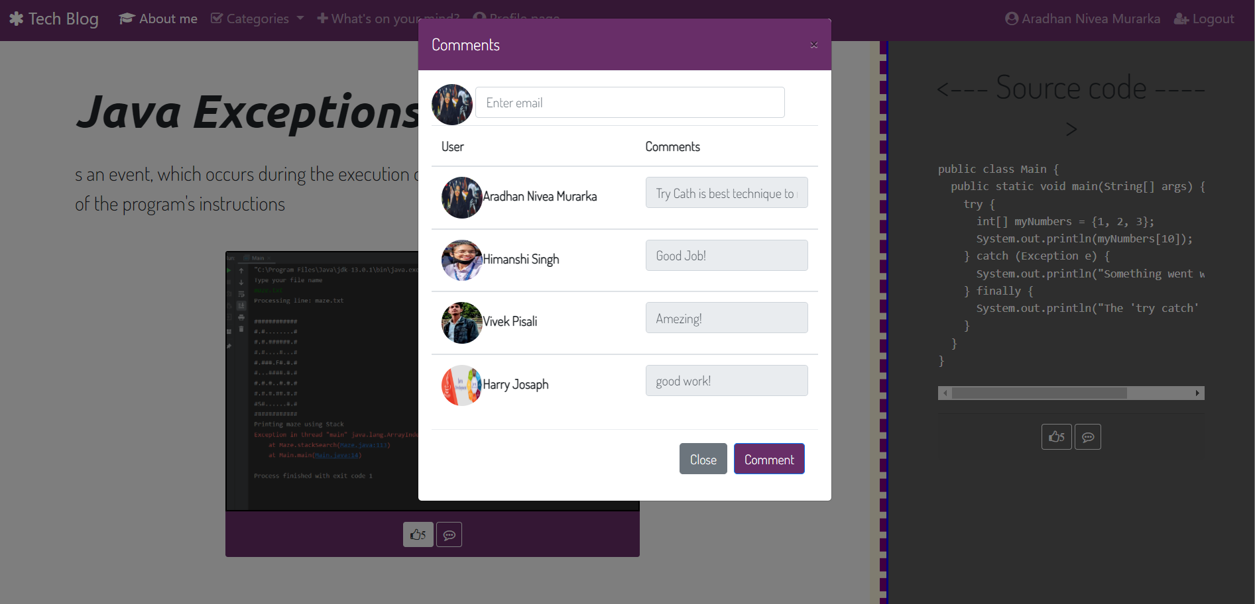
show_blog_page.jsp
Comment Module
Here user can add his/her comments and also view the comments posted by multiple users. And by clicking on there name the user will be able to see all the details except (password) about the ones who commented on this post.

